Slide 1
A PRESENTATION
ON
“ Basics of Machine Learning”
(ECS219L)
-By-
UMESH GUPTA
.
Notes:
1

Slide 2
TYPES OF LEARNING
Supervised Learning
Unsupervised Learning

Slide 3
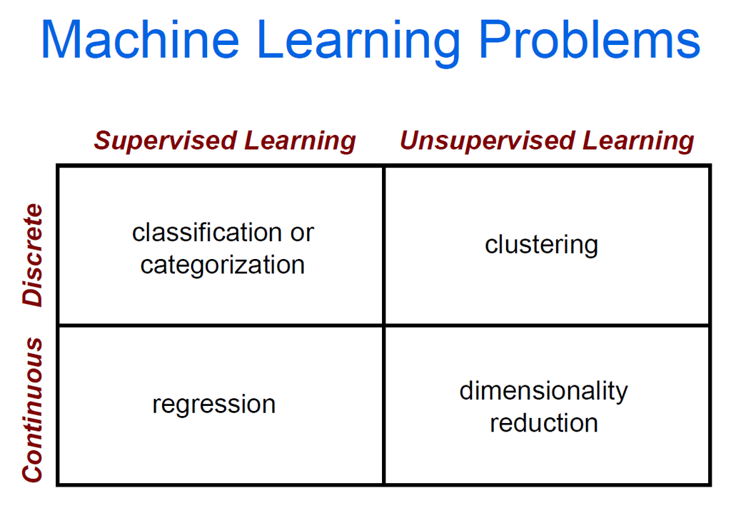
TYPES OF LEARNING

Slide 4



THE MACHINE LEARNING FRAMEWORK
Apply a prediction function to a feature representation of the image to get the desired output:
f( ) = “apple”
f( ) = “tomato”
f( ) = “cow”
Notes:
4

Slide 5
THE MACHINE LEARNING FRAMEWORK
y = f(x)
Training: given a training set of labeled examples {(x₁,y₁), …, (x_{N},y_{N})}, estimate the prediction function f by minimizing the prediction error on the training set
Testing: apply f to a never-before-seen test example x and output the predicted value y = f(x)
output
prediction function
Image feature
Notes:
5

Slide 6
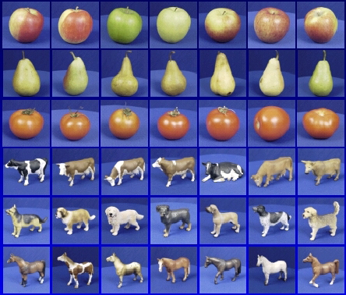

Steps
Training
Training Labels
Training Images
Image Features
Training
Learned model
Testing
Image Features
Learned model
Prediction
Test Image
Notes:
6

Slide 7
Classification
Classification is the process of finding or discovering a model or function which helps in separating the data into multiple categorical classes i.e., discrete values.
In classification, data is categorized under different labels according to some parameters given in input and then the labels are predicted for the data.
In classification problems, our learning algorithm learns a function to map inputs to outputs where the output value is a discrete class label (i.e., cat or dog, malignant or benign, spam or non-spam, etc).

Slide 8
POPULAR CLASSIFIERS
Naïve Bayes
K-nearest neighbour
SVM
Randomized Forests
Bayesian network
Logistic regression
Boosted Decision Trees
RBMs
Neural networks
Which is the best one?

Slide 9
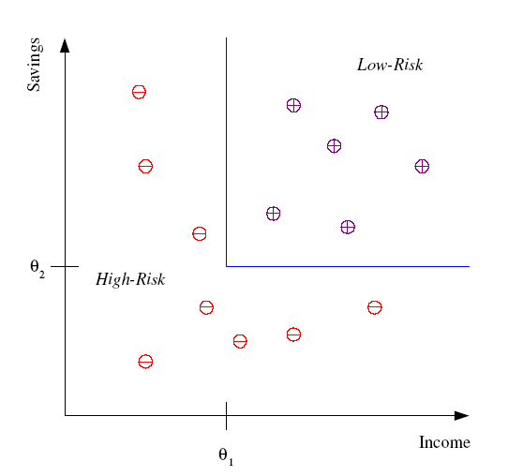
Classification
Example: Credit scoring
Differentiating between low-risk and high-risk customers from their income and savings
Discriminant: IF income > θ₁ AND savings > θ₂
THEN low-risk ELSE high-risk
Model

Slide 10
Classification: Applications
Pattern recognition
Face recognition: Pose, lighting, occlusion (glasses, beard), make-up, hair style
Character recognition: Different handwriting styles.
Speech recognition: Temporal dependency.
Use of a dictionary or the syntax of the language.
Sensor fusion: Combine multiple modalities; eg, visual (lip image) and acoustic for speech
Medical diagnosis: From symptoms to illnesses
Web Advertising: Predict if a user clicks on an ad on the Internet.

Slide 11
Regression
Regression is the process of finding a model or function for distinguishing the data into continuous real values instead of using classes or discrete values.
It can also identify the distribution movement depending on the historical data. Because a regression predictive model predicts a quantity, therefore, the skill of the model must be reported as an error in those predictions
Regression problems are concerned with mapping inputs to outputs where the output is a continuous real number (i.e., the price of a house).

Slide 12
Popular Regression Models
Linear Regression
Ridge Regression
Lasso Regression
Neural Networks Regression
Decision Tree

Slide 13
Popular Regression Models
Some algorithms are either exclusively for regression style problems such as Linear Regression models, and some algorithms are exclusively for classification tasks such as Logistic regression.
However, there are some algorithms that can overlap once small modifications are made to them such as Decision Trees, Random Forest, XGBoost, and Neural Networks.

Slide 14
Clustering
Clustering is the task of dividing the population or data points into a number of groups such that data points in the same groups are more similar to other data points in the same group and dissimilar to the data points in other groups.
It is basically a collection of objects on the basis of similarity and dissimilarity between them.

Slide 15
Clustering
Clustering is very much important as it determines the intrinsic grouping among the unlabeled data present. There are no criteria for a good clustering.
It depends on the user, what is the criteria they may use which satisfy their need. For instance, we could be interested in finding representatives for homogeneous groups (data reduction), in finding “natural clusters” and describe their unknown properties (“natural” data types), in finding useful and suitable groupings (“useful” data classes) or in finding unusual data objects (outlier detection).
This algorithm must make some assumptions which constitute the similarity of points and each assumption make different and equally valid clusters.

Slide 16
Popular Clustering Methods
Density-Based Methods
Hierarchical Based Methods
Partitioning Methods
Grid-based Methods

Slide 17
Popular Clustering Models
Affinity Propagation
Agglomerative Clustering
BIRCH
DBSCAN
K-Means
Mini-Batch K-Means
Mean Shift
OPTICS
Spectral Clustering
Mixture of Gaussians

Slide 18
Dimensionality Reduction
When dealing with high dimensional data, it is often useful to reduce the dimensionality by projecting the data to a lower dimensional subspace which captures the “essence” of the data. This is called dimensionality reduction.

Slide 19
Techniques for Dimensionality Reduction
Principal Component Analysis (PCA)
Linear Discriminant Analysis (LDA)
Generalized Discriminant Analysis (GDA)

Slide 20
Parametric Methods
The basic idea behind the parametric method is that there is a set of fixed parameters that uses to determine a probability model that is used in Machine Learning as well.
Parametric methods are those methods for which we priory knows that the population is normal, or if not then we can easily approximate it using a normal distribution which is possible by invoking the Central Limit Theorem.

Slide 21
Parametric Methods
Parameters for using the normal distribution is –
Mean
Standard Deviation

Slide 22
Parametric Methods
Mean
The mean (also know as average), is obtained by dividing the sum of observed values by the number of observations, n. Although data points fall above, below, or on the mean, it can be considered a good estimate for predicting subsequent data points.
Standard deviation
The standard deviation gives an idea of how close the entire set of data is to the average value. Data sets with a small standard deviation have tightly grouped, precise data. Data sets with large standard deviations have data spread out over a wide range of values.

Slide 23
Parametric Methods
A confidence interval, in statistics, refers to the probability that a population parameter will fall between a set of values for a certain proportion of times.
A range of values so defined that there is a specified probability that the value of a parameter lies within it.
Example: You survey 100 Indians and 100 Americans about their television-watching habits, and find that both groups watch an average of 35 hours of television per week. However, the Indian people surveyed had a wide variation in the number of hours watched, while the Americans all watched similar amounts.
Even though both groups have the same point estimate (average number of hours watched), the Indian estimate will have a wider confidence interval than the American estimate because there is more variation in the data.

Slide 24
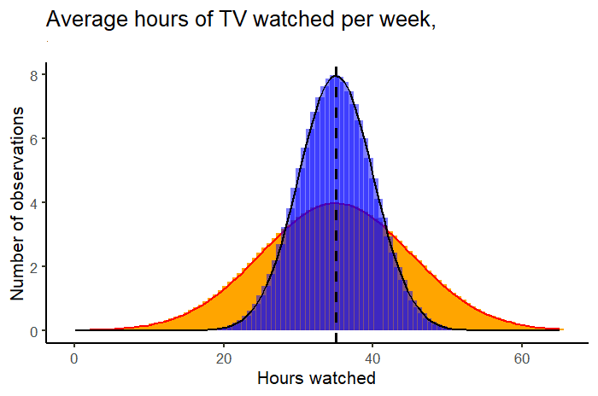
Parametric Methods

Slide 25
Parametric Methods
Eventually, the classification of a method to be parametric is completely depends on the presumptions that are made about a population. There are many parametric methods available some of them are:
1. Confidence interval used for – population mean along with known standard deviation.
2. The confidence interval is used for – population means along with the unknown standard deviation.
3. The confidence interval for population variance.
4. The confidence interval for the difference of two means, with unknown standard deviation.

Slide 26
Nonparametric Methods
In Non-Parametric methods, there is no need to make any assumption of parameters for the given population or the population we are studying. In fact, the methods don’t depend on the population.
Here there is no fixed set of parameters are available, and also there is no distribution (normal distribution, etc.) of any kind is available for use. This is also the reason that nonparametric methods are also referred to as distribution-free methods.

Slide 27
Nonparametric Methods
Nowadays Non-parametric methods are gaining popularity and an impact of influence some reasons behind this fame is –
The main reason is that there is no need to be mannered while using parametric methods.
The second important reason is that we do not need to make more and more assumptions about the population given (or taken) on which we are working on.
Most of the nonparametric methods available are very easy to apply and to understand also i.e. the complexity is very low.

Slide 28
Nonparametric Methods
There are many nonparametric methods are available today but some of them are –
Spearman correlation test
Sign test for population means
U-test for two independent means
Bootstrapping techniques
Parametric vs non-parametric methods

Slide 29








Face Recognition
Training examples of a person
Test images

Slide 30
Standard Statistical Distributions
A sample of data will form a distribution, and by far the most well-known distribution is the Gaussian distribution, often called the Normal distribution.
The distribution provides a parameterized mathematical function that can be used to calculate the probability for any individual observation from the sample space.
This distribution describes the grouping or the density of the observations, called the probability density function.
We can also calculate the likelihood of an observation having a value equal to or lesser than a given value. A summary of these relationships between observations is called a cumulative density function.
Examples: Normal distribution, the Binomial distribution, the Poisson distribution and the Uniform distribution.

Slide 31
Standard Statistical Distributions
A probability density function (PDF) can be used to calculate the likelihood of a given observation in a distribution. It can also be used to summarize the likelihood of observations across the distribution’s sample space.
Plots of the PDF show the familiar shape of a distribution, such as the bell-curve for the Gaussian distribution.
A cumulative density function(CDF) is a different way of thinking about the likelihood of observed values. Rather than calculating the likelihood of a given observation as with the PDF, the CDF calculates the cumulative likelihood for the observation and all prior observations in the sample space.
It allows you to quickly understand and comment on how much of the distribution lies before and after a given value. A CDF is often plotted as a curve from 0 to 1 for the distribution.

Slide 32
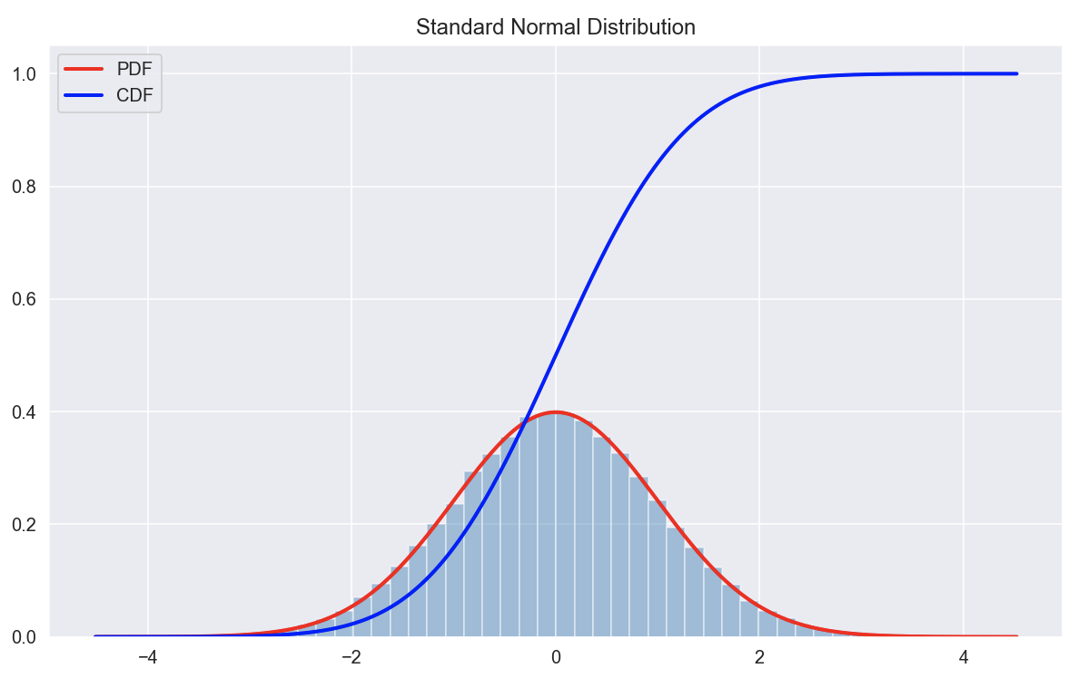
Standard Statistical Distributions

Slide 33
The Normal Distribution
Normal distribution describes continuous data which have a symmetric distribution, with a characteristic 'bell' shape.
It is often the case with medical data that the histogram of a continuous variable obtained from a single measurement on different subjects will have a characteristic `bell-shaped' distribution known as a Normal distribution. One such example is the histogram of the birth weight (in kilograms) of the 3,226 newborn babies shown in Figure 1.
Example: Heights of people, Measurement errors, Blood pressure, Points on a test, IQ scores, Salaries.

Slide 34
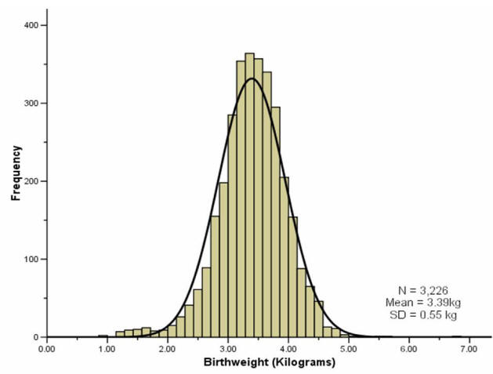
The Normal Distribution

Slide 35
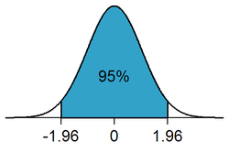
The Normal Distribution
The Normal distribution is completely described by two parameters μ and σ, where μ represents the population mean, or center of the distribution, and σ the population standard deviation.
It is symmetrically distributed around the mean. Populations with small values of the standard deviation σ have a distribution concentrated close to the center μ;
Those with large standard deviation have a distribution widely spread along the measurement axis.
One mathematical property of the Normal distribution is that exactly 95% of the distribution lies between.
μ−(1.96xσ) and μ+(1.96xσ)
Changing the multiplier 1.96 (standard deviations of the mean) to 2.58, exactly 99% of the Normal distribution lies in the corresponding interval.

Slide 36
The Normal Distribution
In practice the two parameters of the Normal distribution, μ and σ, must be estimated from the sample data. For this purpose, a random sample from the population is first taken. The sample mean x¯ and the sample standard deviation, SD(x¯)= S , are then calculated. If a sample is taken from such a Normal distribution, and provided the sample is not too small, then approximately 95% of the sample lie within the interval:
x¯−[1.96×SD(x¯)] to x¯+[1.96×SD(x¯)]
This is calculated by merely replacing the population parameters μ and σ by the sample estimates x¯ and SD in the previous expression.
So, a reference range for our sample of babies, using the values given in the histogram above, is:
3.39 - [1.96 x 0.55] to 3.39 + [1.96 x 0.55]
2.31kg to 4.47kg

Slide 37
Elementary Probability Theory
A probability gives the likelihood that a defined event will occur. It is quantified as a positive number between 0 (the event is impossible) and 1 (the event is certain). Thus, the higher the probability of a given event, the more likely it is to occur.
If A is a defined event, then the probability of A occurring is expressed as P(A). Probability can be expressed in a number of ways. A frequentist approach is to observe a number of particular events out of a total number of events. Thus, we might say the probability of a boy is 0.52, because out of a large number of singleton births we observe 52% are boys.
A model-based approach is where a model, or mechanism determines the event; thus, the probability of a ‘1’ from an unbiased die is 1/6 since there are 6 possibilities, each equally likely and all adding to one.
An opinion-based approach is where we use our past experience to predict a future event, so we might give the probability of our favorite football team winning the next match, or whether it will rain tomorrow.

Slide 38
Elementary Probability Theory
Addition Rule
The addition rule is used to determine the probability of at least one of two (or more) events occurring. In general, the probability of either event A or B is given by:
P(A or B) = P(A) + P(B) – P(A and B)
If A and B are mutually exclusive, this means they cannot occur together, i.e., P(A and B)=0. Therefore, for mutually exclusive events the probability of either A or B occurring is given by:
P(A or B) = P(A) + P(B)
Example: If event A is that a person is blood group O and event B is that they are blood group B, then these events are mutually exclusive since a person may only be either one or the other. Hence, the probability that a given person is either group O or B is P(A)+P(B).

Slide 39
Elementary Probability Theory
Multiplication Rule
The multiplication rule gives the probability that two (or more) events happen together. In general, the probability of both events A and B occurring is given by:
P(A and B) = P(A) x P(B|A) = P(B) x P(A|B)
The notation P(B|A) is the probability that event B occurs given that event A has occurred where the symbol ‘|’ is read is ‘given’. This is an example of a conditional probability, the condition being that event A has happened.
For example: the probability of drawing the ace of hearts from a well shuffled pack is 1/51. The probability of the ace of hearts given that the card is red is 1/26.

Slide 40
Elementary Probability Theory
Multiplication Rule
If A and B are independent events, then the probability of event B is unaffected by the probability of event A (and vice versa). In other words, P(B|A) = P(B). Therefore, for independent events, the probability of both events A and B occurring is given by:
P(A and B) = P(A) x P(B)
Example: If event A is that a person is blood group O and event B that they are diabetic, then the probability of someone having blood group O and being diabetic is P(A) x P(B), assuming that getting diabetes is unrelated to a person’s blood group.
Note that if A and B are mutually exclusive, then P(A|B)=0

Slide 41
Elementary Probability Theory
Bayes’ Theorem
From the multiplication rule above, we see that:
P(A) x P(B|A) = P(B) x P(A|B)
This leads to what is known as Bayes' theorem:
Thus, the probability of B given A is the probability of A given B, times the probability of B divided by the probability of A. This formula is not appropriate if P(A)=0, that is if A is an event which cannot happen.
P(B|A)=(P(A|B) P(B)) / P(A)

Slide 42
Elementary Probability Theory
1. Maximum Likelihood
2. Bayes theorem in machine learning as Naïve Bayes Classifier
3. Minimax theory
Why Bayes Theorem?
Bayes Theorem is a method to determine conditional probabilities – that is, the probability of one event occurring given that another event has already occurred. Because a conditional probability includes additional conditions – in other words, more data – it can contribute to more accurate results.
Thus, conditional probabilities are a must in determining accurate predictions and probabilities in Machine Learning.

Slide 43
Prerequisite for Naïve Bayes Theorem
Let’s understand some terms through an example. Consider a bookstore manager has information about his customers’ age and income. He wants to know how book sales are distributed across three age-classes of customers: youth (18-35), middle-aged (35-60), and seniors (60+).
Let us term our data X. In Bayesian terminology, X is called evidence. We have some hypothesis H, where we have some X that belongs to a certain class .
Our goal is to determine the conditional probability of our hypothesis H given X, i.e., P(H | X).
In simple terms, by determining P(H | X), we get the probability of X belonging to class C, given X.
X has attributes of age and income – let’s say, for instance, 26 years old with an income of $2000.
H is our hypothesis that the customer will buy the book.

Slide 44
Prerequisite for Naïve Bayes Theorem
Evidence – As discussed earlier, P(X) is known as evidence. It is simply the probability that the customer will, in this case, be of age 26, earning $2000.
Prior Probability – P(H), known as the prior probability, is the simple probability of our hypothesis – namely, that the customer will buy a book. This probability will not be provided with any extra input based on age and income. Since the calculation is done with lesser information, the result is less accurate.
Posterior Probability – P(H | X) is known as the posterior probability. Here, P(H | X) is the probability of the customer buying a book (H) given X (that he is 26 years old and earns $2000).
Likelihood – P(X | H) is the likelihood probability. In this case, given that we know the customer will buy the book, the likelihood probability is the probability that the customer is of age 26 and has an income of $2000.

Slide 45
Naïve Bayes
Naïve Bayes algorithm is a simple classifier that based on the Bayes’ Theorem to classify data into various classes with accuracy and speed.
Let class_{i} be diabetes risk group i and V be input variables that are used in a model and under the assumption of all variables are independent.
To predict a class of diabetes risk, a model of Naive Bayes can be defined by
where P(class_{i}|V) is a posterior probability of a training data set with variable V that will be class_{i}. P(V|class_{i}) is a likelihood of a training data set of class_{i} and variable V where V is equal to P(class_{i}) is a probability of diabetes risk group i.

Slide 46
Continued..
The above model can be written as
Hence, the prediction class will be class_{i} when it gives the highest value of P(class_{i} |V).

Slide 47
Continued..
Spam Classification
Given an email, predict whether it is spam or not
Medical Diagnosis
Given a list of symptoms, predict whether a patient has disease X or not
Weather
Based on temperature, humidity, etc.… predict if it will rain tomorrow

Slide 48

UMESH GUPTA-NITAP
48

